Slide 1

Software Testing
Debugging
Instructor: Kaveh Eshraghian

Slide 2
Overview
Debugging Definition
Debugging Process
Types of Errors
Debugging Techniques
Debugging Clues

Slide 3
Debugging
Definition:
The process of identifying and removing errors/bugs from computer software/hardware.
How:
Using print statements
Creating and reviewing log files
Using an interactive debugger
Notes:
Print statement -> Smaller and simpler software -> Buffer Output Issue -> when a program terminates suddenly, output can be left in a buffer -> Causing the programmer to believe that the code was in a different position than it really was when it terminated -> To get around this problem, you should flush the output streams regularly
Log files -> More complex software running on multiple machines within the network
Interactive debugger -> for more complex software running on one machine

Slide 4
Debugging Process
Gather Evidence
Interpret
Evidence
Fix Bug
Test Code
Start
Failed
Done
Passed

Slide 5
Types of Errors
Syntactic errors
You code does not follow rules of the language.
Detected and reported at compile time.
Easy to fix.
Semantic errors
Logic errors in the running program.
More difficult to find and fix.
Requires the use of debugging techniques.
Requirements errors
We are building the wrong program.
Clarify requirements.

Slide 6
Syntactic Errors
Errors
Severe and stop compilation
Need to be corrected before continuing
Warnings
Do not stop compilation
Indicates that something unusual has been found
Often points to a possible semantic error
Should NOT be ignored
Programmers should strive for a program with no warnings

Slide 7
Linker Errors
Definition:
Linker errors are mismatches between the compiled symbols and the libraries that use them.
functions.c
Compiler
functions.obj
Textually included
functions.h
Linker
main.exe
Textually included
main.c
Compiler
main.obj
Notes:
The linker produces its own error messages which say one of two things:
It was looking for something and could not find it,
It was looking for something and found two or more of it.
linker goes looking for a variable or function, it expects to find one of what it is looking for.
-> Finds Zero -> Cannot complete
-> Finds Two -> Doesn’t know which to use
The common reasons for getting a message from the linker are:
you wrote the declaration for a function or variable and forgot to write the definition,
you forgot you already defined a function or variable and defined it twice,
you accidentally used the same name in different parts of the program,
you omitted one of the object files that should have been sent to the linker.

Slide 8

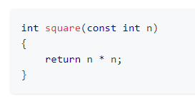
Declaration Vs Definition
Declaration:
the name of the function.
the number and type of the parameters.
the type returned by the function.
Definition:
what the function does.
what the linker is looking for.

Slide 9
Extern Declarations
Declaration
Definition
#ifndef HEADER_H #define HEADER_H
// declares type of n extern int n; #endif
#ifndef HEADER_H #define HEADER_H
// allocates memory for n int n; #endif
Notes:
Definition -> This means that it allocates memory for it and associates the memory address with the name n. If you include this into two implementation files, it will allocate memory for the same variable twice. When the object files are sent to the linker, it will find two areas of memory associated with the same variable and not know which one to use, resulting in a linker error.
Declaration -> Keyword extern indicates that this is just type information for the variable and that it will be defined elsewhere. This transforms a definition into a declaration. Therefore, the variable n must be declared in the header and defined in exactly one of the implementation files.

Slide 10
Debugging Techniques
When debugging you need to know:
Where the program was executing when the bug occurred,
Whether the point of termination of the program was where the bug occurred
If the program produced incorrect results, where is the bug?
How did this line of code ever get executed?
What are the values of the variables as the program executes?
Notes:
There are numerous techniques you can use to try and track down the bugs in a program. When you are tracking down bugs, you need to know several pieces of information:

Slide 11
Debugging Clues
Most Common Reasons of bugs:
Segmentation Faults
Bus Error
Random Behavior
Program Executing Wrong Code
Variable Changing Value
Working on some Compilers
Program Stopping Unexpectedly
Memory Errors
Numeric Problems
Non-Zero Return Code
Notes:
As you gain experience, you will find that there are certain giveaways as to what might be the source of the bug.
Bugs which totally stump novice programmers are often solved in a couple of minutes by experienced programmers.
Below I will go through some of the most common reasons for bugs and how to identify them.

Slide 12
Segmentation Faults
Definition:
A program attempting to access memory that has been not allocated to it.
Outcome:
Generates segmentation fault.
Normally results in termination.
Most Common Reasons:
Subscripts which run off the end of an array.
A pointer containing an invalid address.
A NULL pointer.
An uninitialized variable.
Accessing memory which has been deallocated.
Notes:
Modern computers and operating systems have the concept of protected memory.
This means that they are easily able to recognize memory which is allocated for use by your program versus memory which has been allocated for use by another program.

Slide 13
Bus Error
Definition:
A program attempting to access illegal memory/ memory which does not exist.
Outcome:
Same as segmentation fault
Notes:
The bus error is similar to the segmentation fault in that it is in illegal memory access.
The difference between the two is that segmentation fault address is valid memory that is not allocated to your program whereas a bus error access is memory which does not exist.
The reasons for the bus error are similar to that of a segmentation fault and you should follow them down using the same debugging techniques.

Slide 14
Random Behavior
Problem Definition:
A program behaving differently on every execution of the software.
Outcome:
Unexpected behavior on every launch.
Most Common Reasons:
Uninitialized Variables, caused by accessing random memory.
Notes:
The reason the program is behaving randomly is because every time it accesses a variable it gets the value that was in that location previously.

Slide 15
Executing Wrong Code
Problem Definition:
Program is executing code that it should not have been executing.
Outcome:
Part of a stack trace missing.
Most Common Reasons:
Bad pointer
Notes:
your program is executing code that there is no way it should have been executing
part of the stack trace might be missing
your program took a random jump and ended up in some code that it shouldn't have ended up here

Slide 16
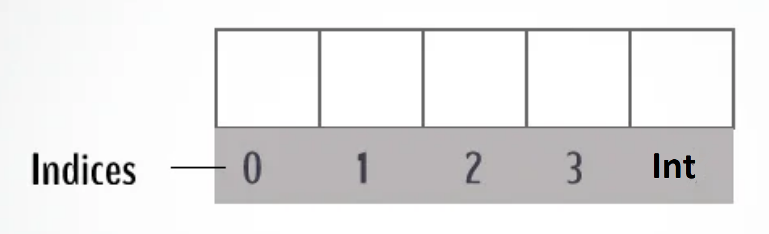
Variable Changing Value
Problem Definition:
A variable within the program is changing its value on Its own.
Most Common Reasons:
Running off the end of an array
Using a bad pointer
Notes:
if a variable seems to have changed its value on its own, then some other piece of code must have changed the value.
Often it is the result of running off the end of an array or using a bad pointer which does not reach outside your memory space for your program but just accesses valid memory within your program.
Compilers generally layout memory linearly as the variables are declared. Take a look at where you declared the variable whose value is being changed. If you find it is declared right before or after an array then check to make sure that the bounds of those arrays are not being exceeded.

Slide 17
Working on Some Compilers
Problem Definition:
Programs behave differently on different compilers and OS.
Most Common Reasons:
Different compilers in different OS do different things.
Windows zeros memory, while Unix does not.
Different memory allocation and layout
Notes:
Most students think that this is a fault of the computer or the compiler. While it is possible that the computer or the compiler can make mistakes this is extremely rare. These compilers are used by thousands and thousands of people every day and if there is a bug in them it is found and corrected quickly. It is far more likely that the problem is in your program.
For example, on Unix operating systems, memory is usually not zeroed out before being given to a new program. On Windows you could always depend on your memory to have been zeroed out before being handed to your program
Some compilers will do byte alignment where they extend variables to give them a little extra space for the word size of a particular computer. If you switch to a computer with a different word size then it will have different padding between variables to make sure that the variables start on a word boundary.

Slide 18
Program Stopping Unexpectedly
Problem Definition:
program stops in the middle of execution for no reason.
Most Common Reasons:
Might have handled an exception or a signal.
Used a try-catch and done nothing with it.

Slide 19
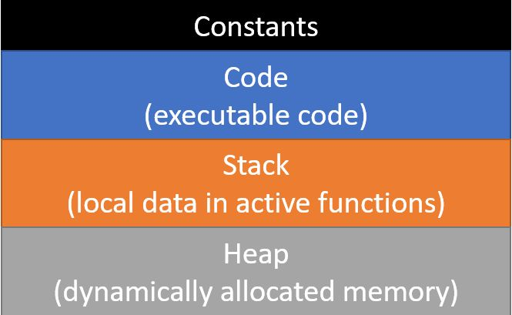
Memory Layout
Application memory is broken into 4 main parts:
Notes:
Computer memory for an application is divided into four main parts:
an area for constants. When you create a constant in a program, it is stored directly in the image on disk. This means that the constants are loaded into memory along with the executable code. This saves having to assign values to them at run-time since their values are assigned as part of the loading of the program.
An area holding the executable code. This is the binary representation of the code you wrote that is ready to run.
A stack onto which stack frames are placed every time a function is called. The stack frames contain the memory for all the local variables inside the function. Each time a function is called, a new stack frame is created for it and, when the function returns, the stack frame is removed from the run-time stack. The next function call will place a new frame on the stack which will overwrite a previous stack frame, destroying any values stored there. When you inherit space on the stack which was used previously, it will have the values from the previous function in it and you need to initialize all your variables to avoid getting random values in them.
A heap from which memory can be dynamically allocated. This is what is used when you use the new and delete operators in C++ or the allocate and free functions in C. The heap is automatically managed to find memory of the size you need and to make memory that was freed available for reuse. These algorithms get very confused if you delete the same memory twice, leading to unpredictable errors.
Some languages, like Java and C#, offer managed memory.
This means that there is a new operator to allocate a new object but no delete operator
These languages keep a count of the number of references there are in a program to each dynamically allocated variable.
When that count drops to zero, no one is using the variable, it is marked available for reuse.
A separate thread runs a garbage collector which is responsible for gathering unused variables
Some of these languages allow you to give hints to the garbage collector to run and reclaim memory

Slide 20
Memory Layout Issues
Out of stack Space
Storing a very large number of local variables or large arrays as local variables inside the functions.
A case of infinite recursion.
Out of Heap Memory
Allocating too much memory
Memory leak
Notes:
Out of Stack ->
You're storing a very large number of local variables or large arrays as local variables inside the functions. If this is the case, you should consider reducing the number of variables or using dynamic allocation to allocate the space from the heap rather than from the stack.
You have a case of infinite recursion. Recursion is defined as when a function calls itself.
Exhausting heap memory occurs because you allocated too much memory, which is actually fairly rare, or you have a memory leak. A memory leak is when you allocate memory but you never free it.

Slide 21
Numeric Problems
List of numeric Problems:
Incorrect Results - might used integer arithmetic and lost the fractional part of a number.
Results start OK but then change sign - Numbers are stored such that if a number gets too big, it wraps around and becomes negative. The problem is that you are using too small a type to store the number.
Inf - this means that the result of the calculation is infinity. Look for division by zero or other arithmetic problem
NaN - Not a Number. Often due to divide by zero but might be for another reason. Regardless, the value is not a valid number
Prints a strange value - Check your format codes to make sure you are not printing an int as a float or similar type problem in a printf.

Slide 22
Non-Zero Return Code
Problem Definition:
Non-zero return codes are normally used for failure cases.
Most common reasons:
Divide by zero
Out of memory
Review:
Try running the code and stopping at various points until you hit the bug.
This might give a clue as to where it is occurring.
Repeatedly narrow it down until you find the line on which it occurs.

